Slide 1

T1A2: Portfolio
Valentinas Kornijenka

Slide 2
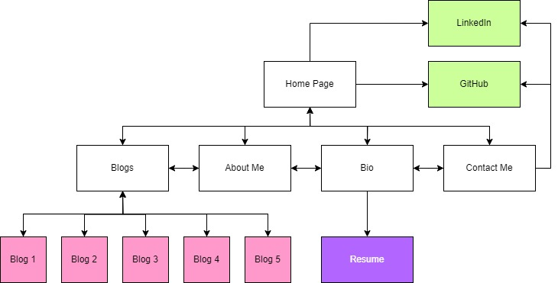
Sitemap

Slide 3
Home Page

Slide 4
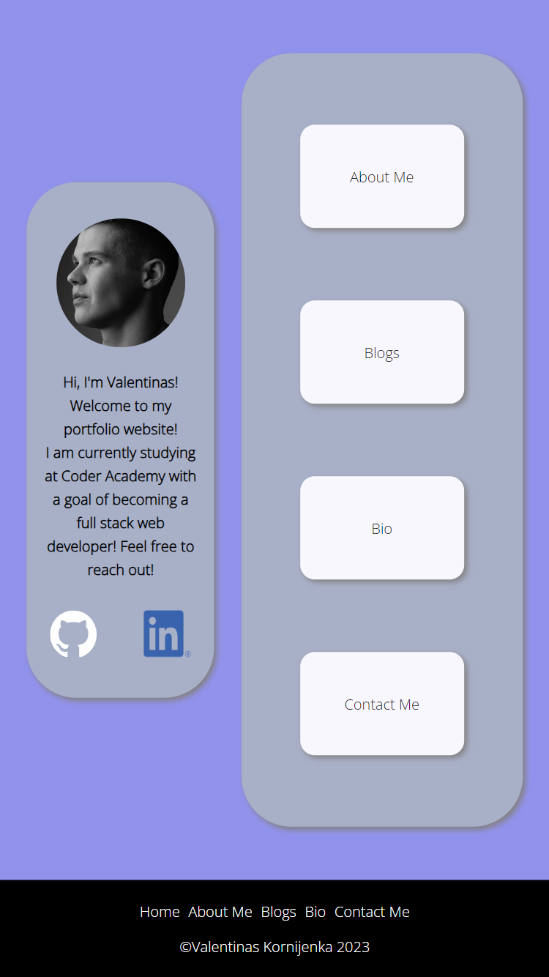
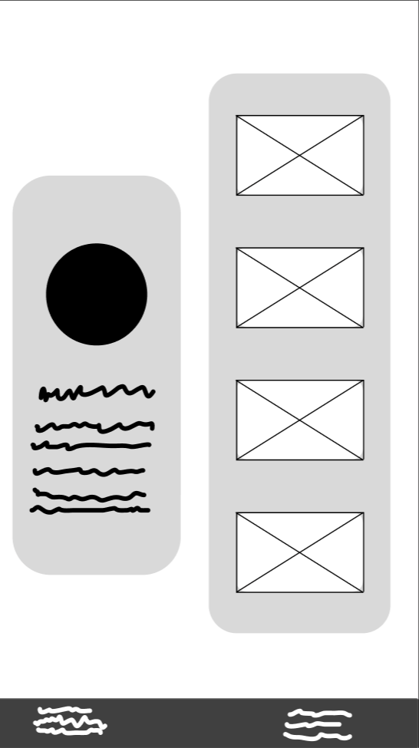
Phone
Border-radius: 0.225rem
Box shadow
Changed footer
Navigation changes from column to row.
Navigation button changes colour with transition.

Slide 5
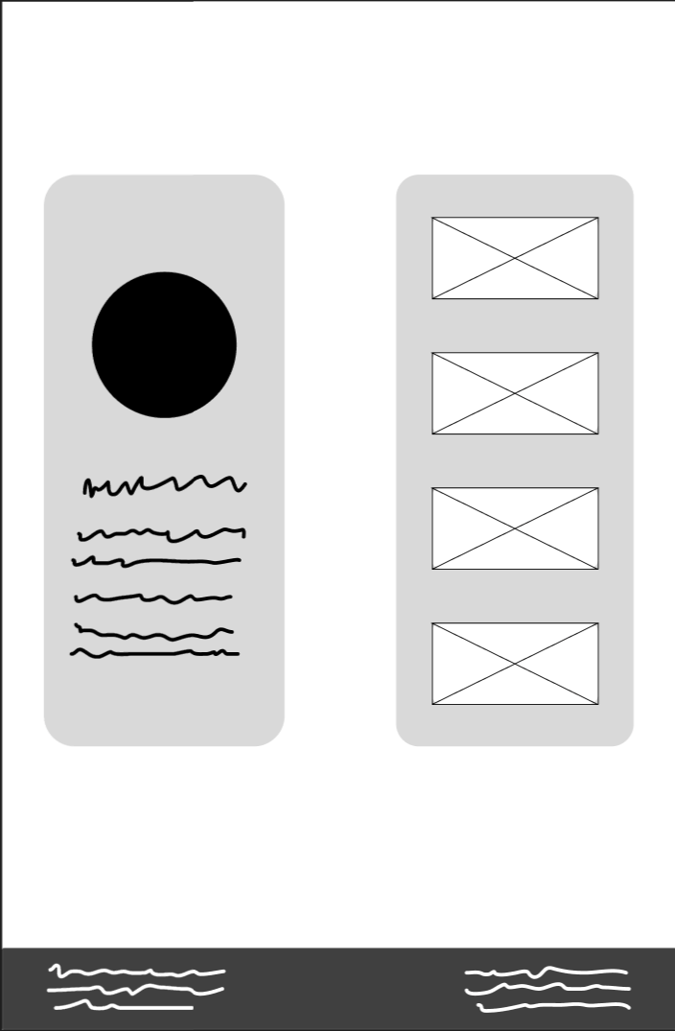
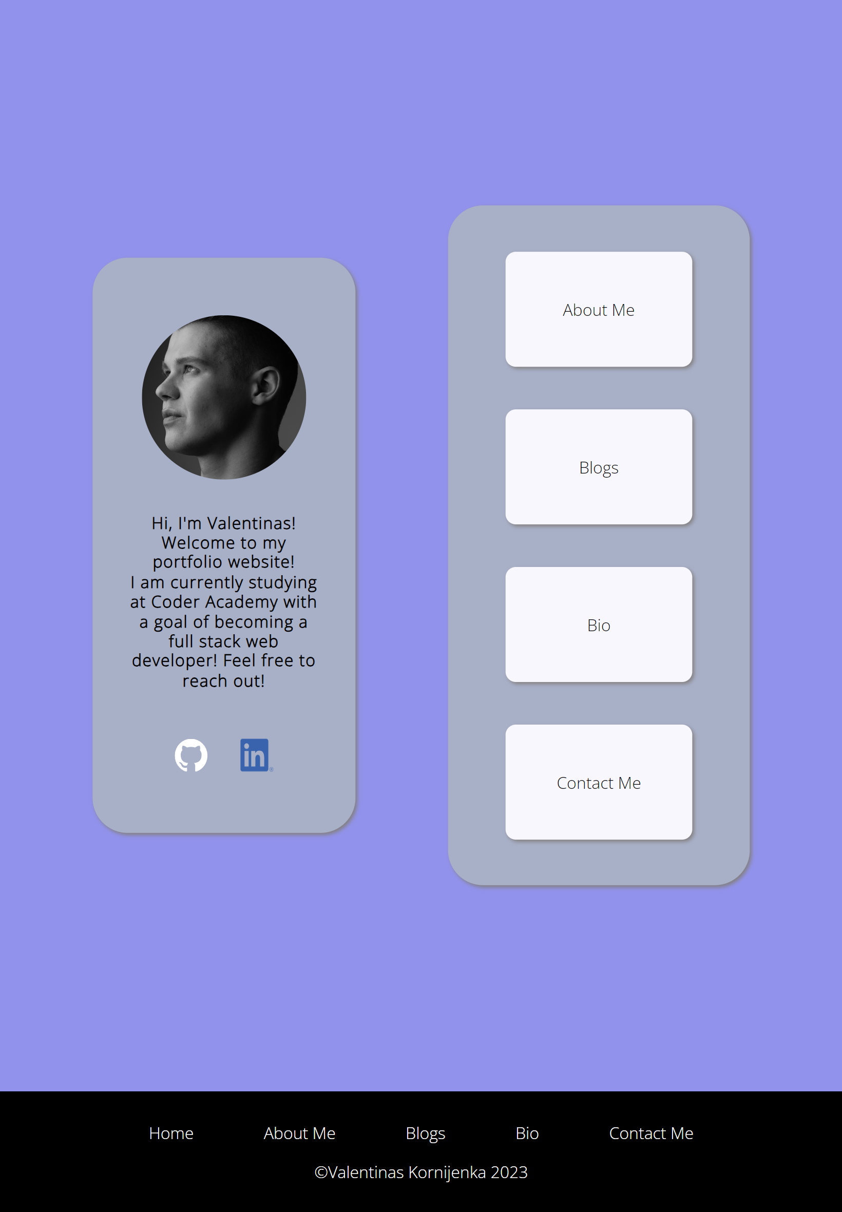
Tablet

Slide 6
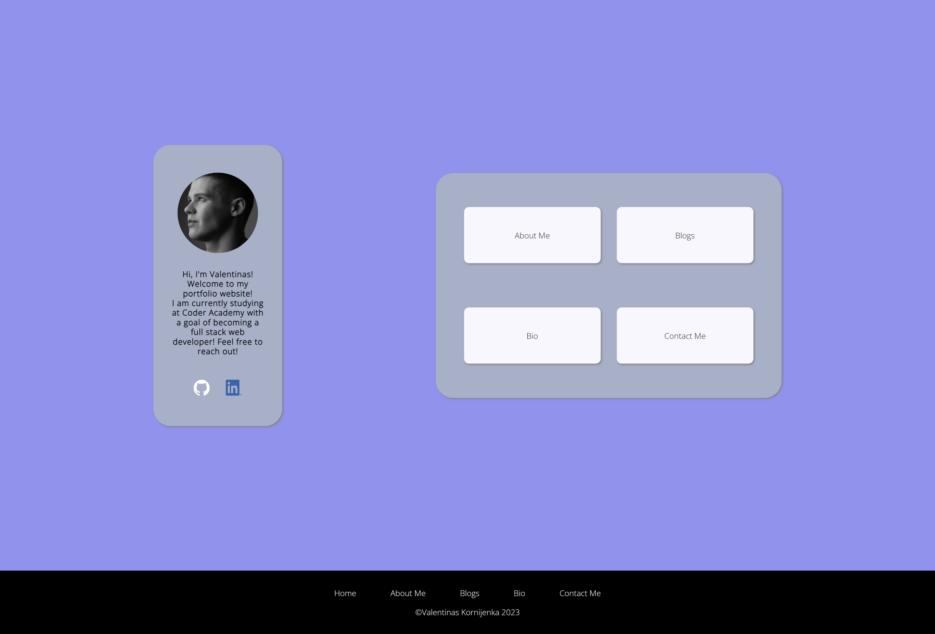
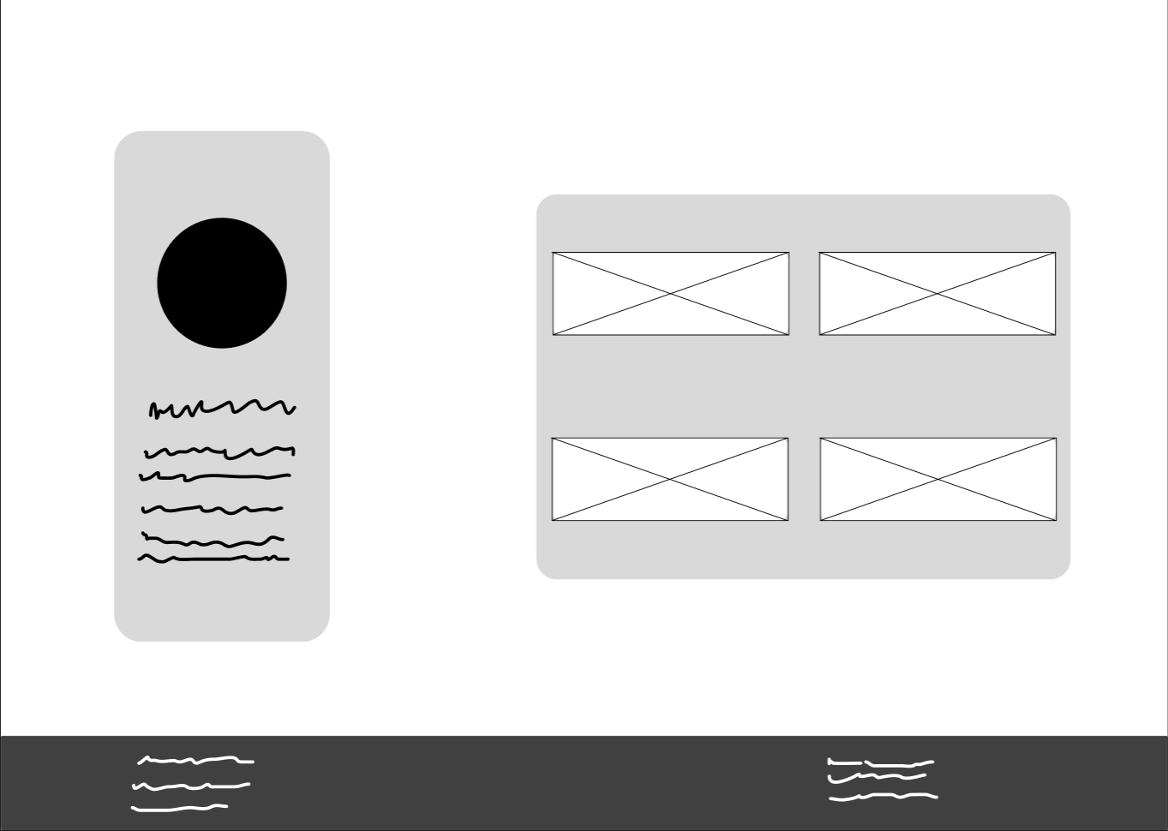
Desktop

Slide 7
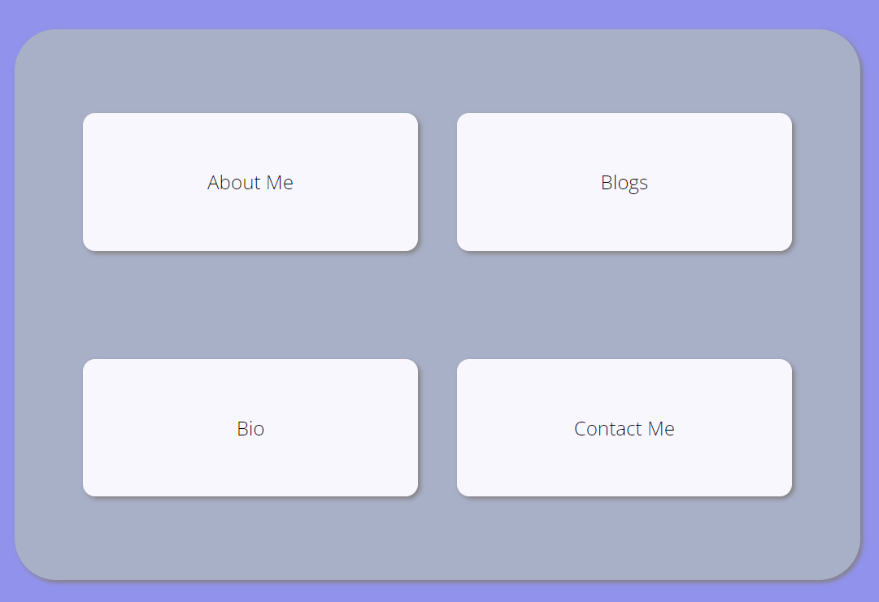
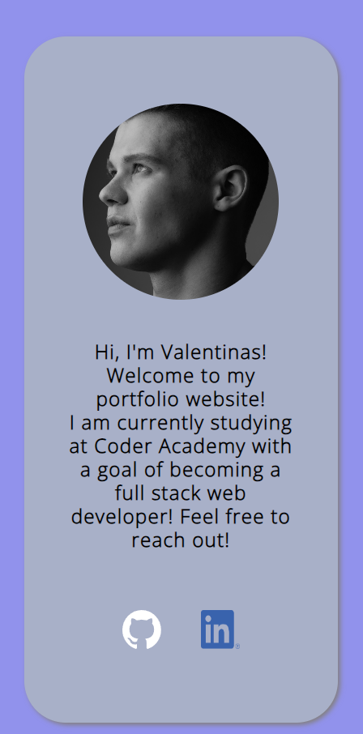
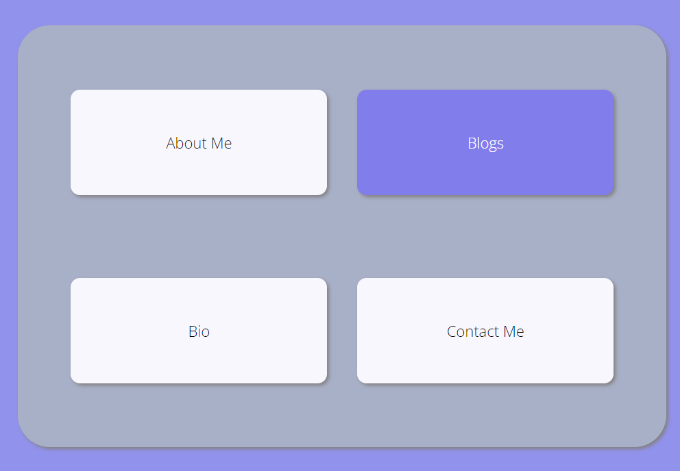
Main Components
Home Navigation Component
Intro + Social Component
Doesn’t include top navbar to distinguish as landing page
Includes socials for ease of access.
Animated, with a 2s transition.

Slide 8
Recurring Components

Slide 9
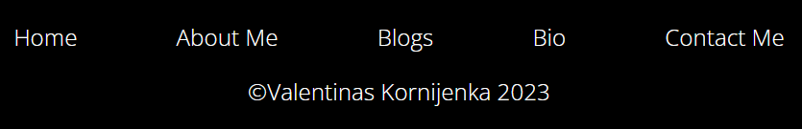
Footer Component
On all pages
Changes from wireframe
Shrinks on tablet/phone

Slide 10
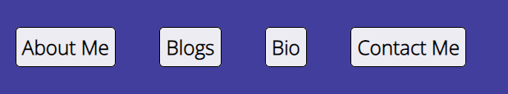

Nav Bar Component
Animated, with a 2s transition.
On all pages besides the Home page.

Slide 11
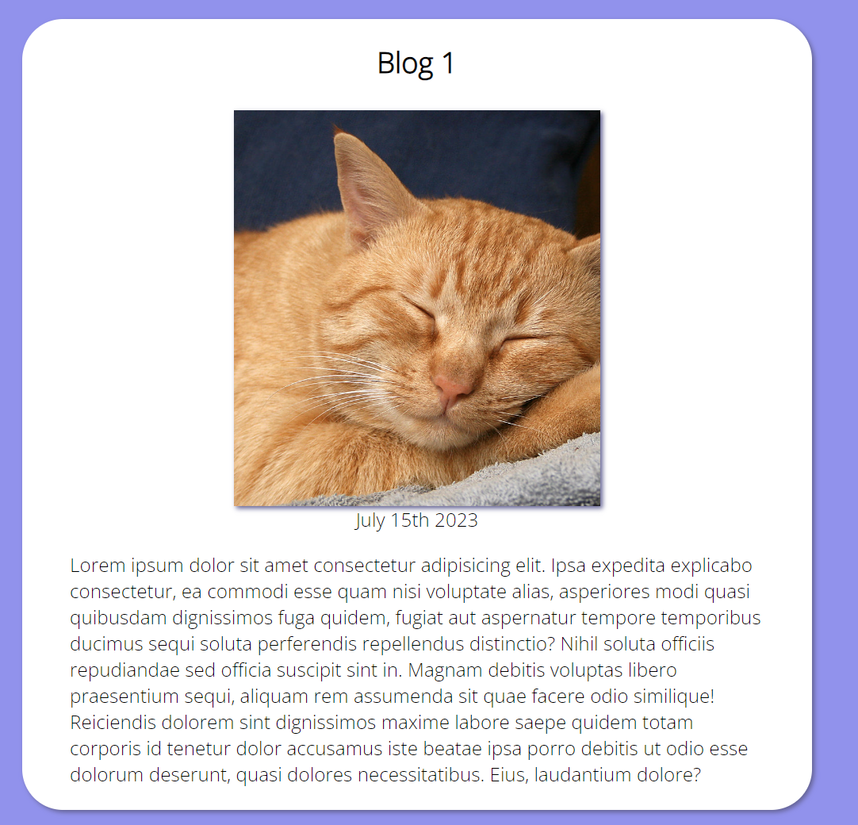
Main Container Components
Border-radius: 0.225rem
Box shadow

Slide 12
About Me Page

Slide 13
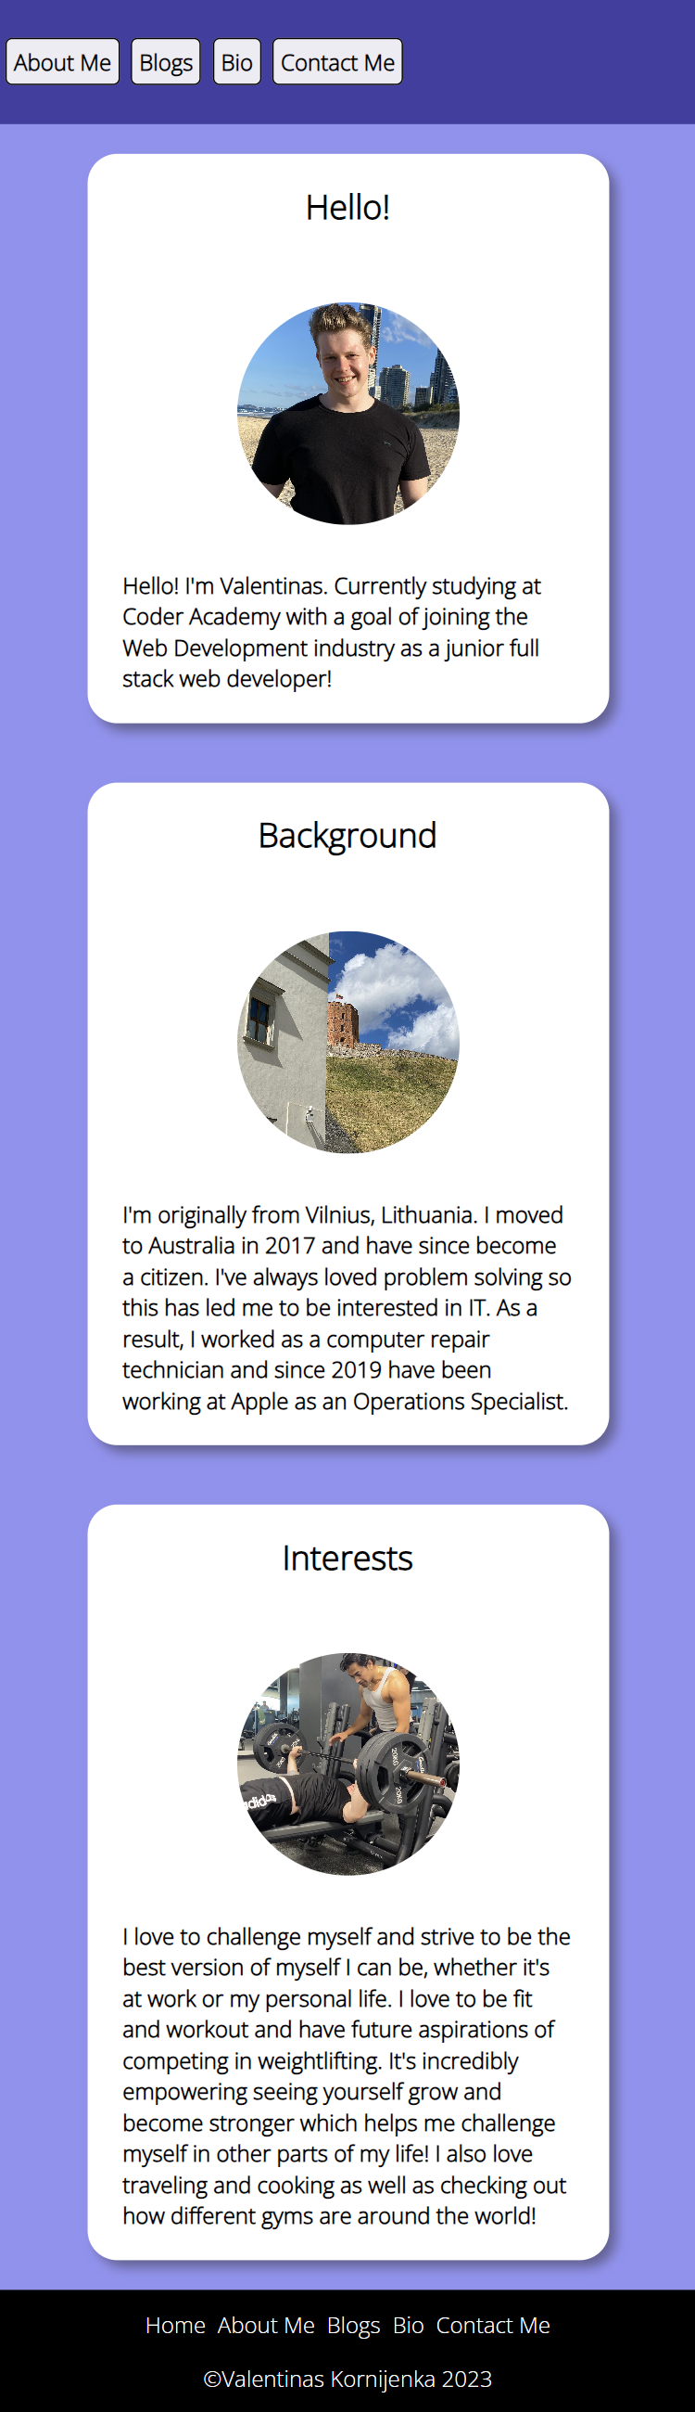
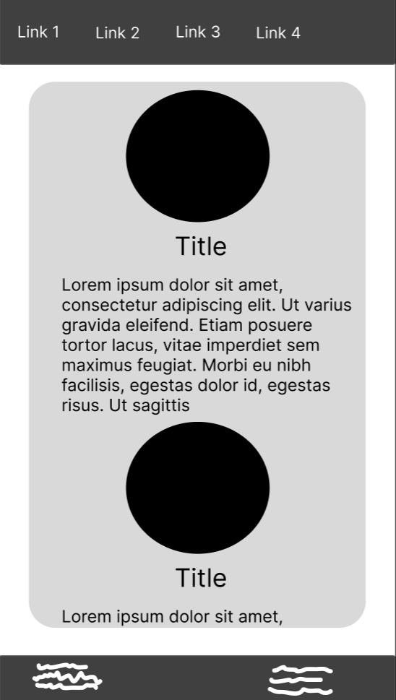
Phone
Changed main component to individual boxes for each section

Slide 14
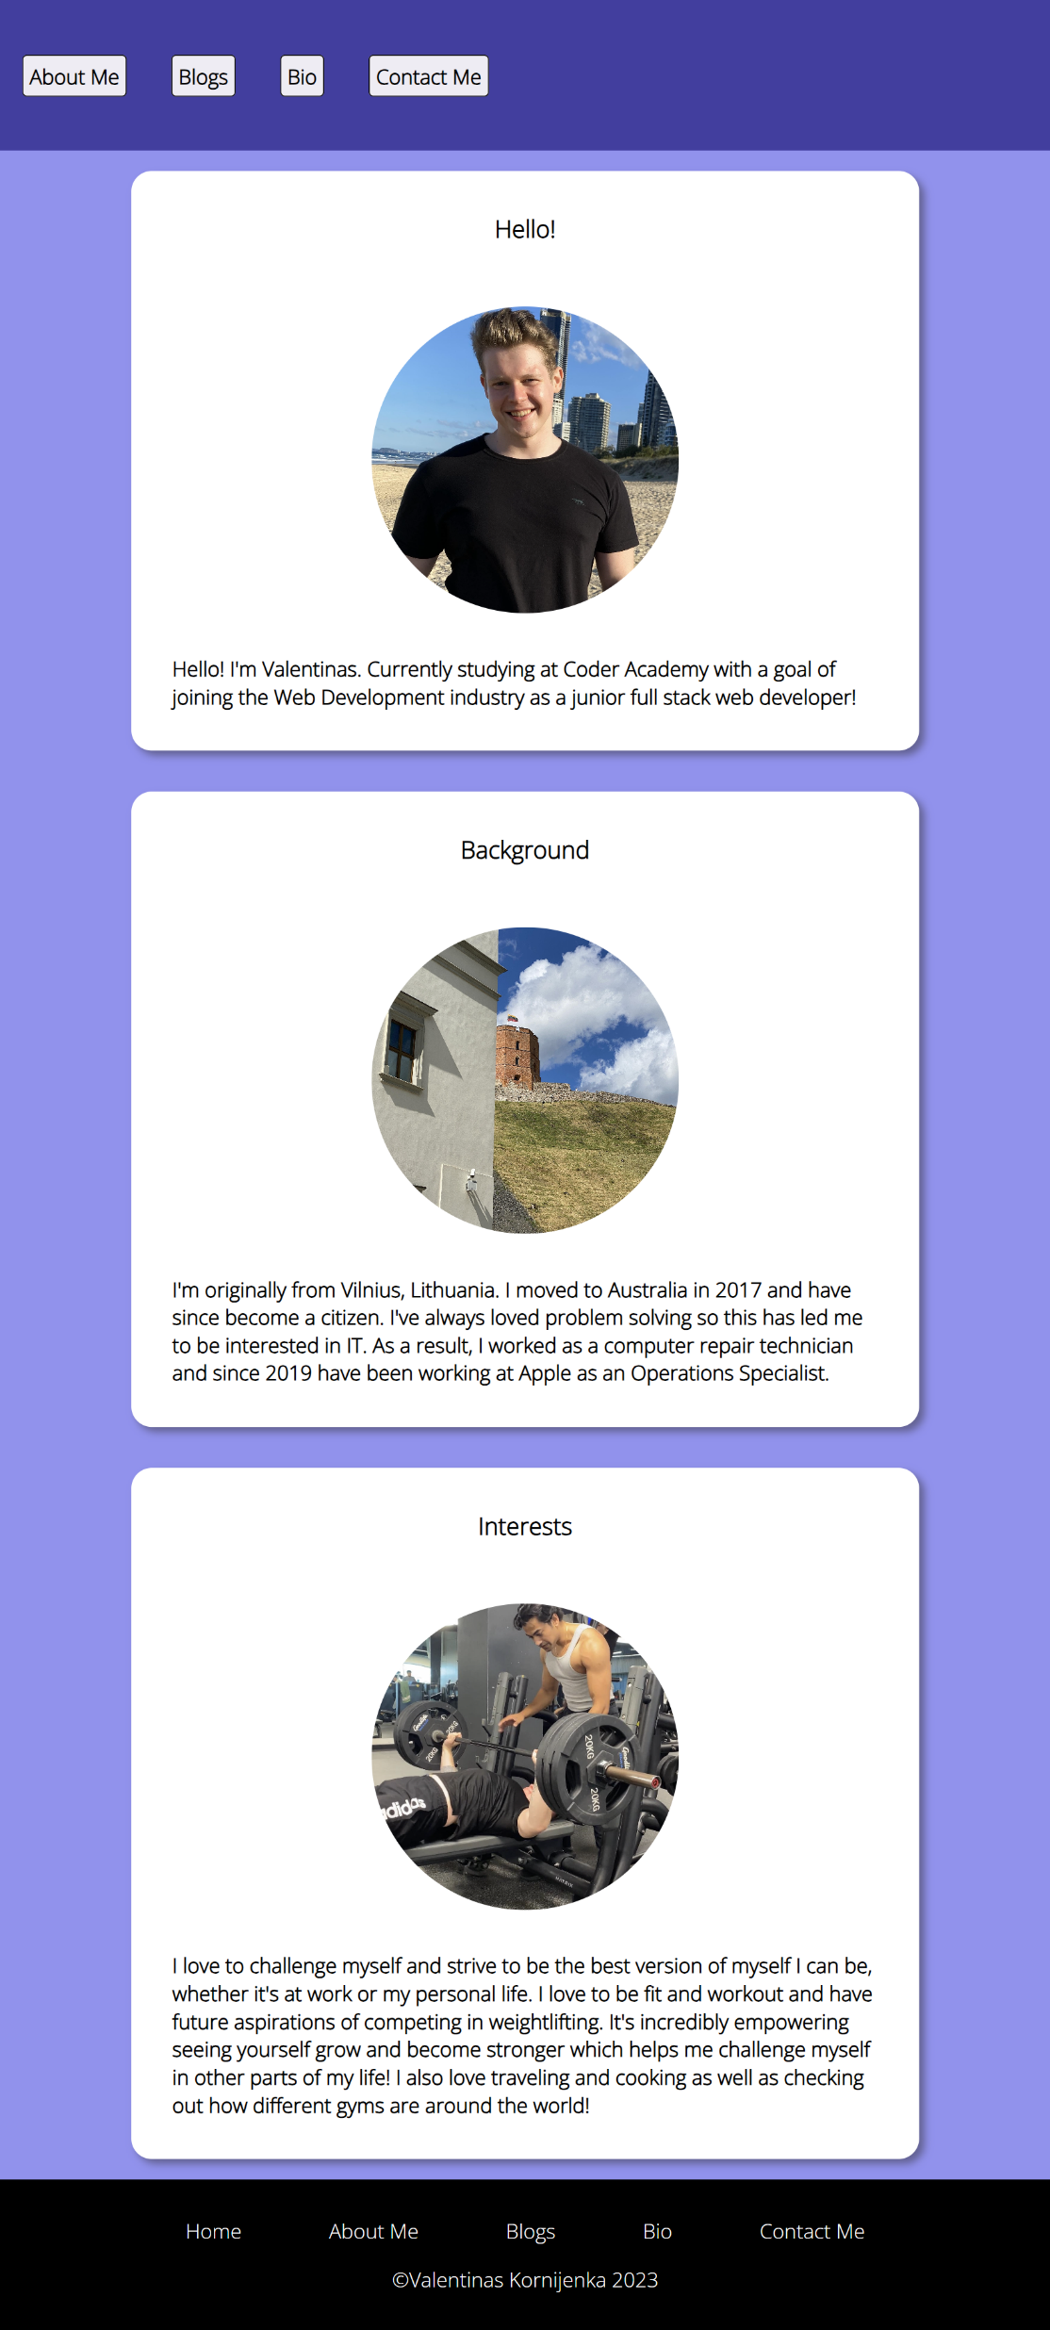
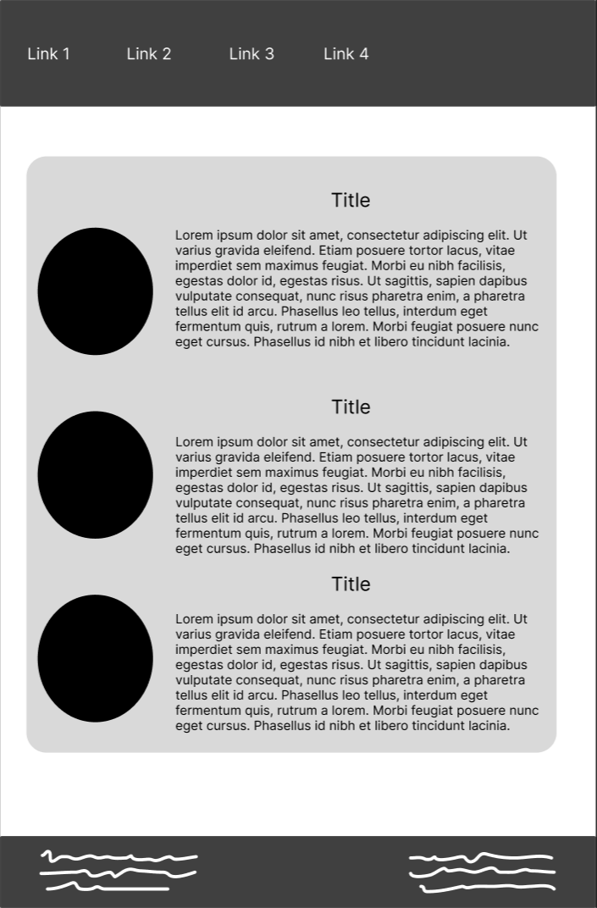
Tablet
Kept individual box design rather than singular box for aesthetic appeal.

Slide 15
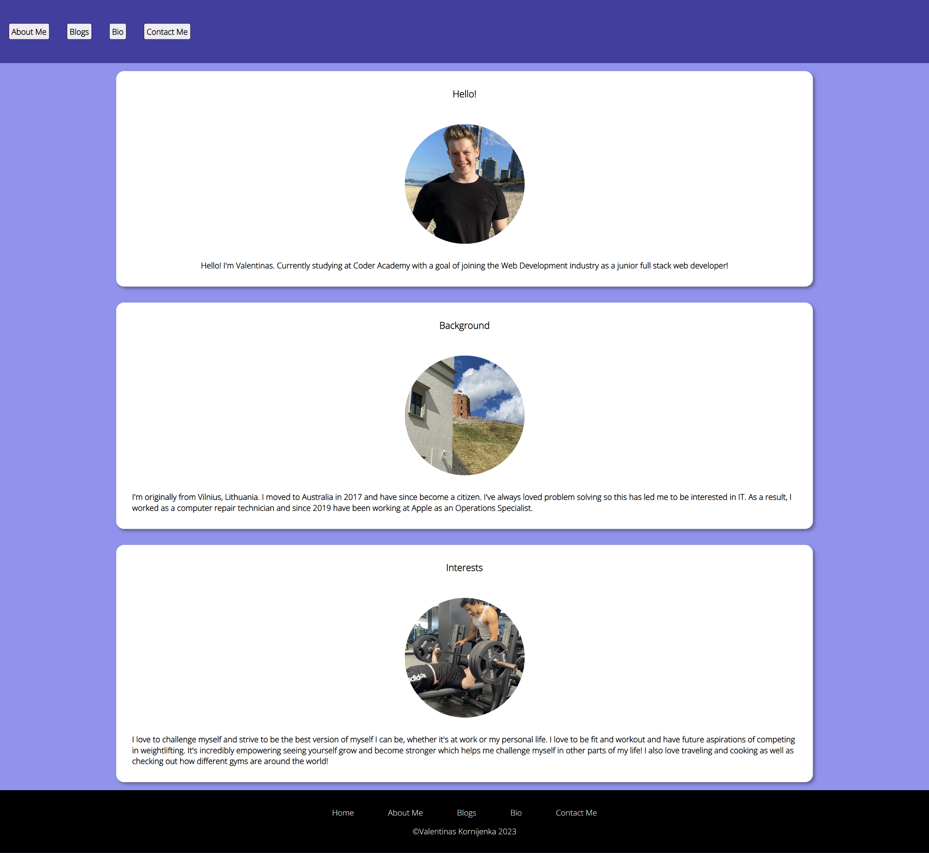
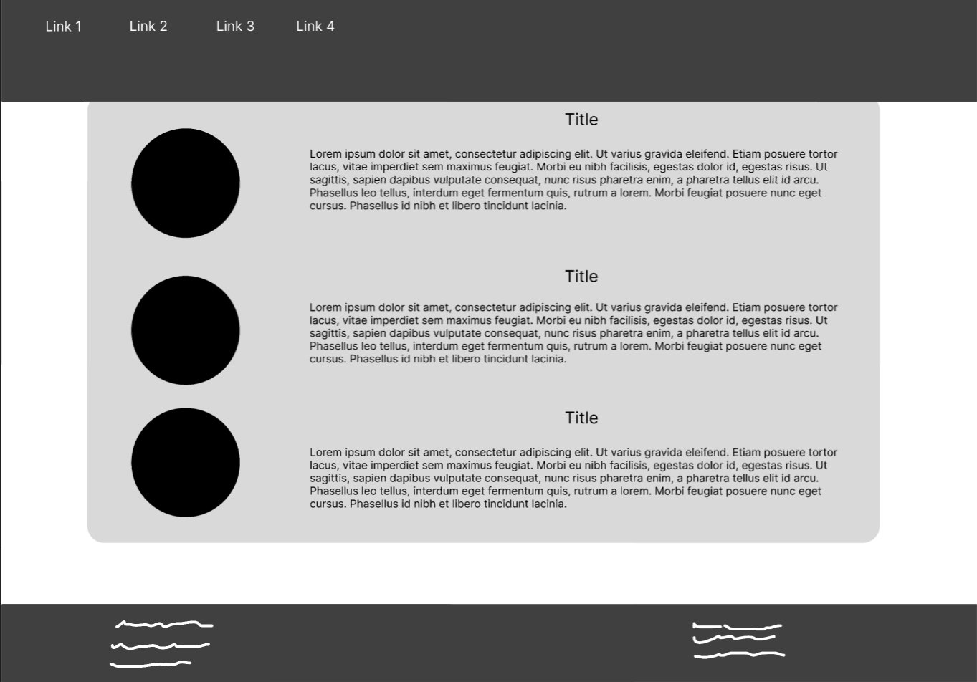
Desktop

Slide 16
Bio Page

Slide 17
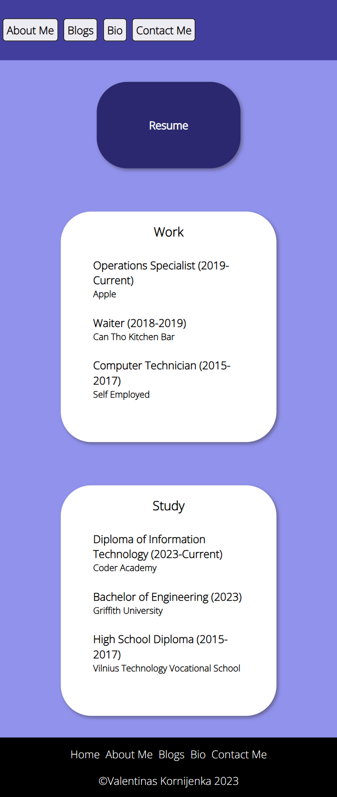
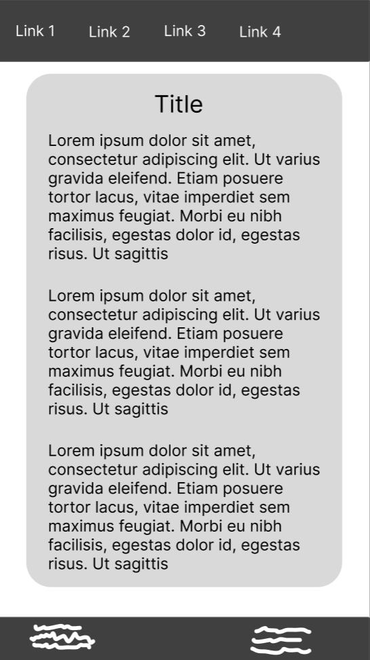
Phone
Added resume button
Changed experience component into boxes for aesthetic appeal.

Slide 18
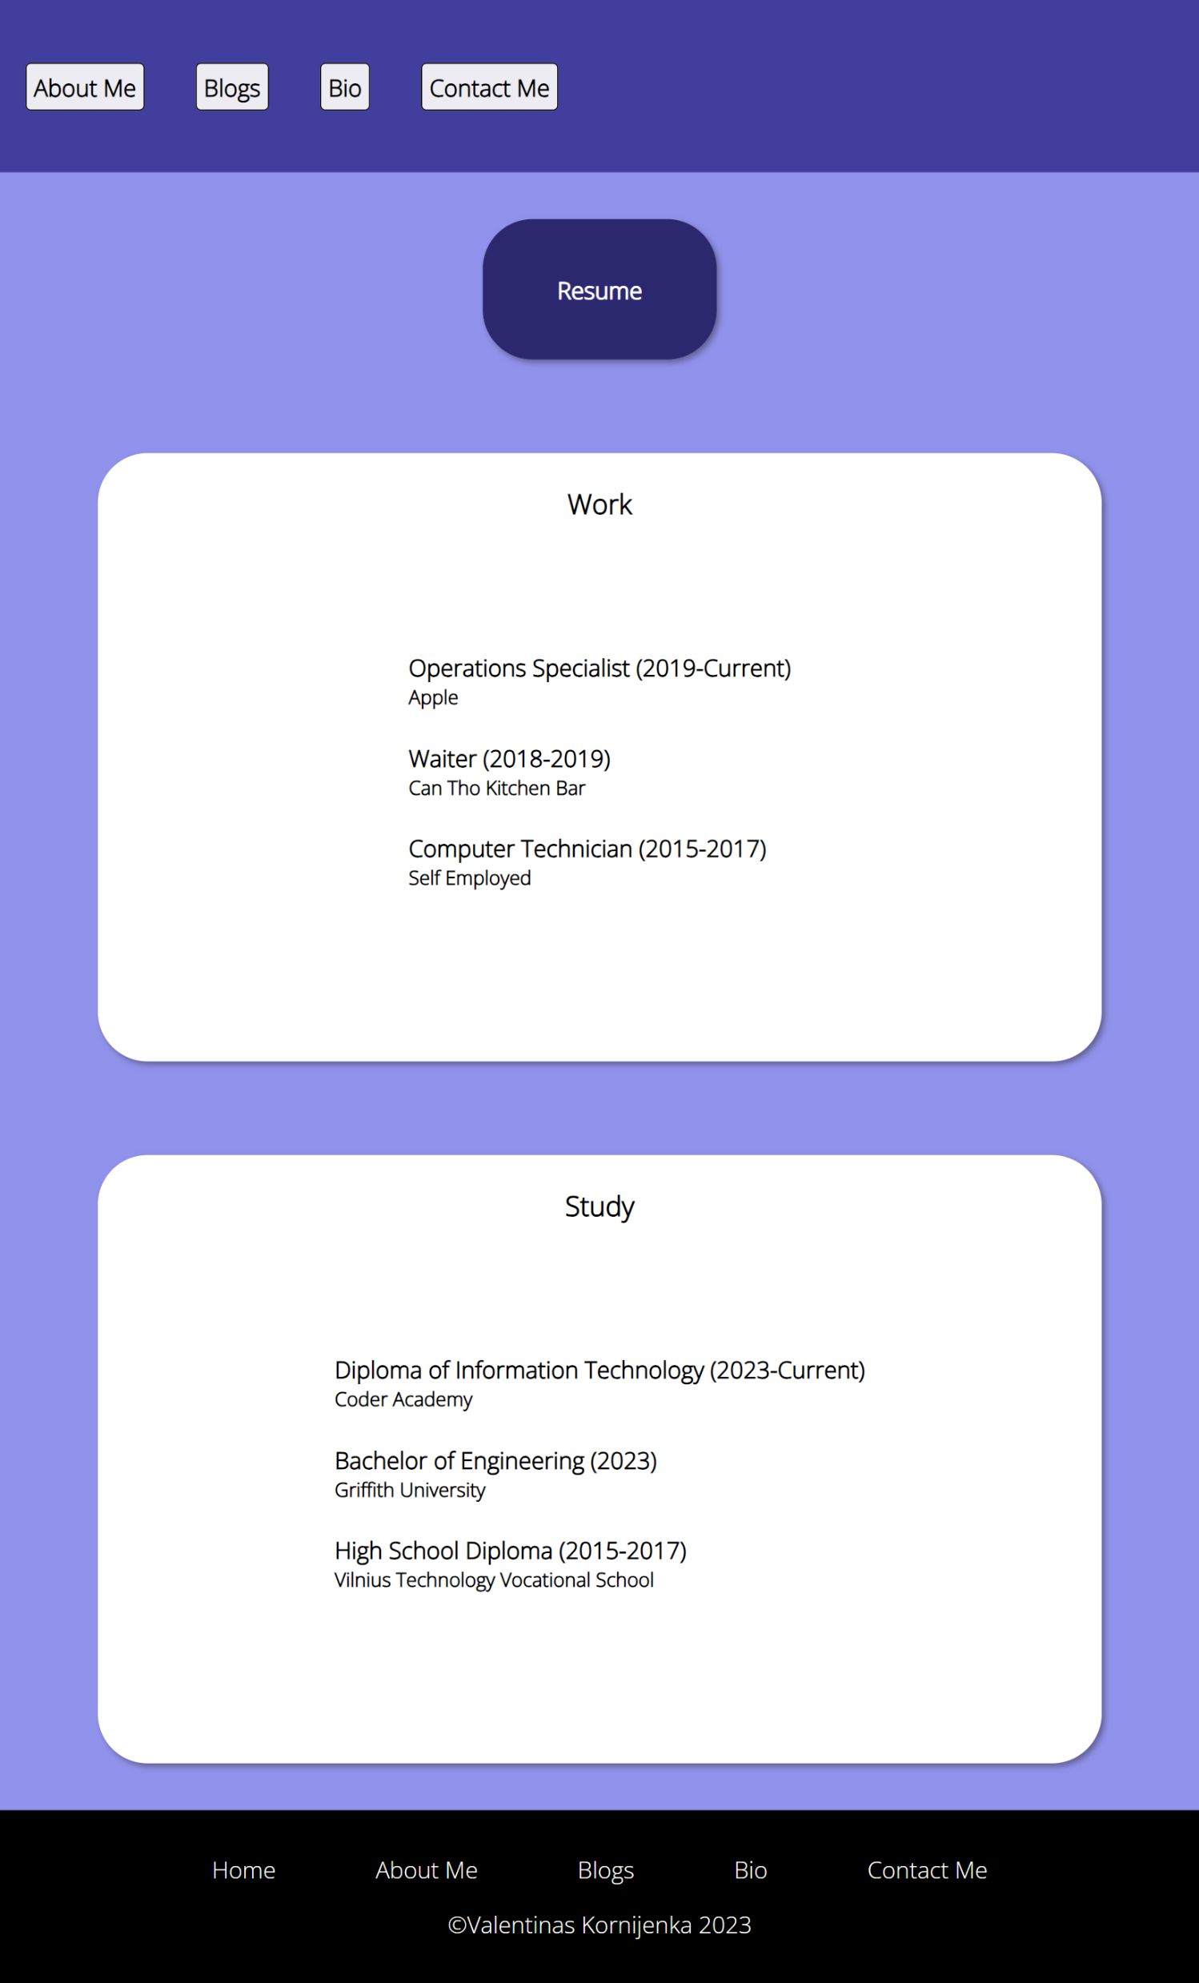
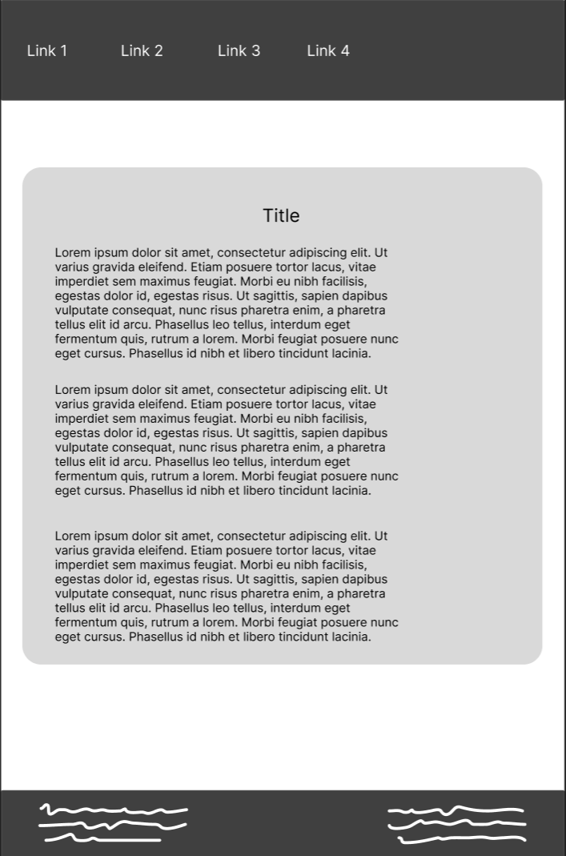
Tablet

Slide 19
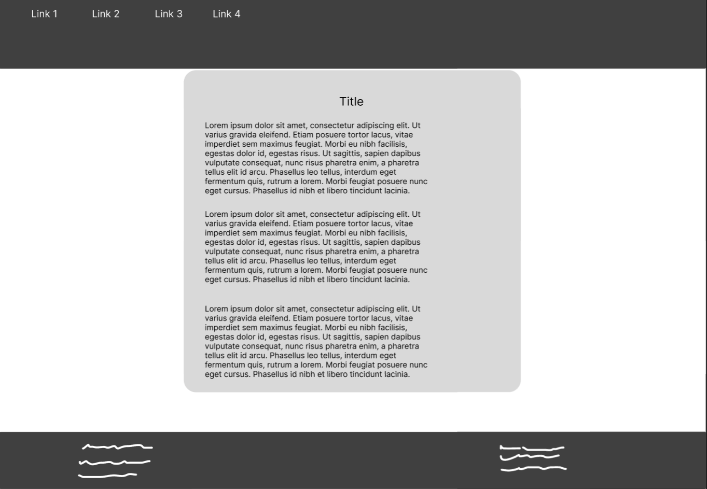
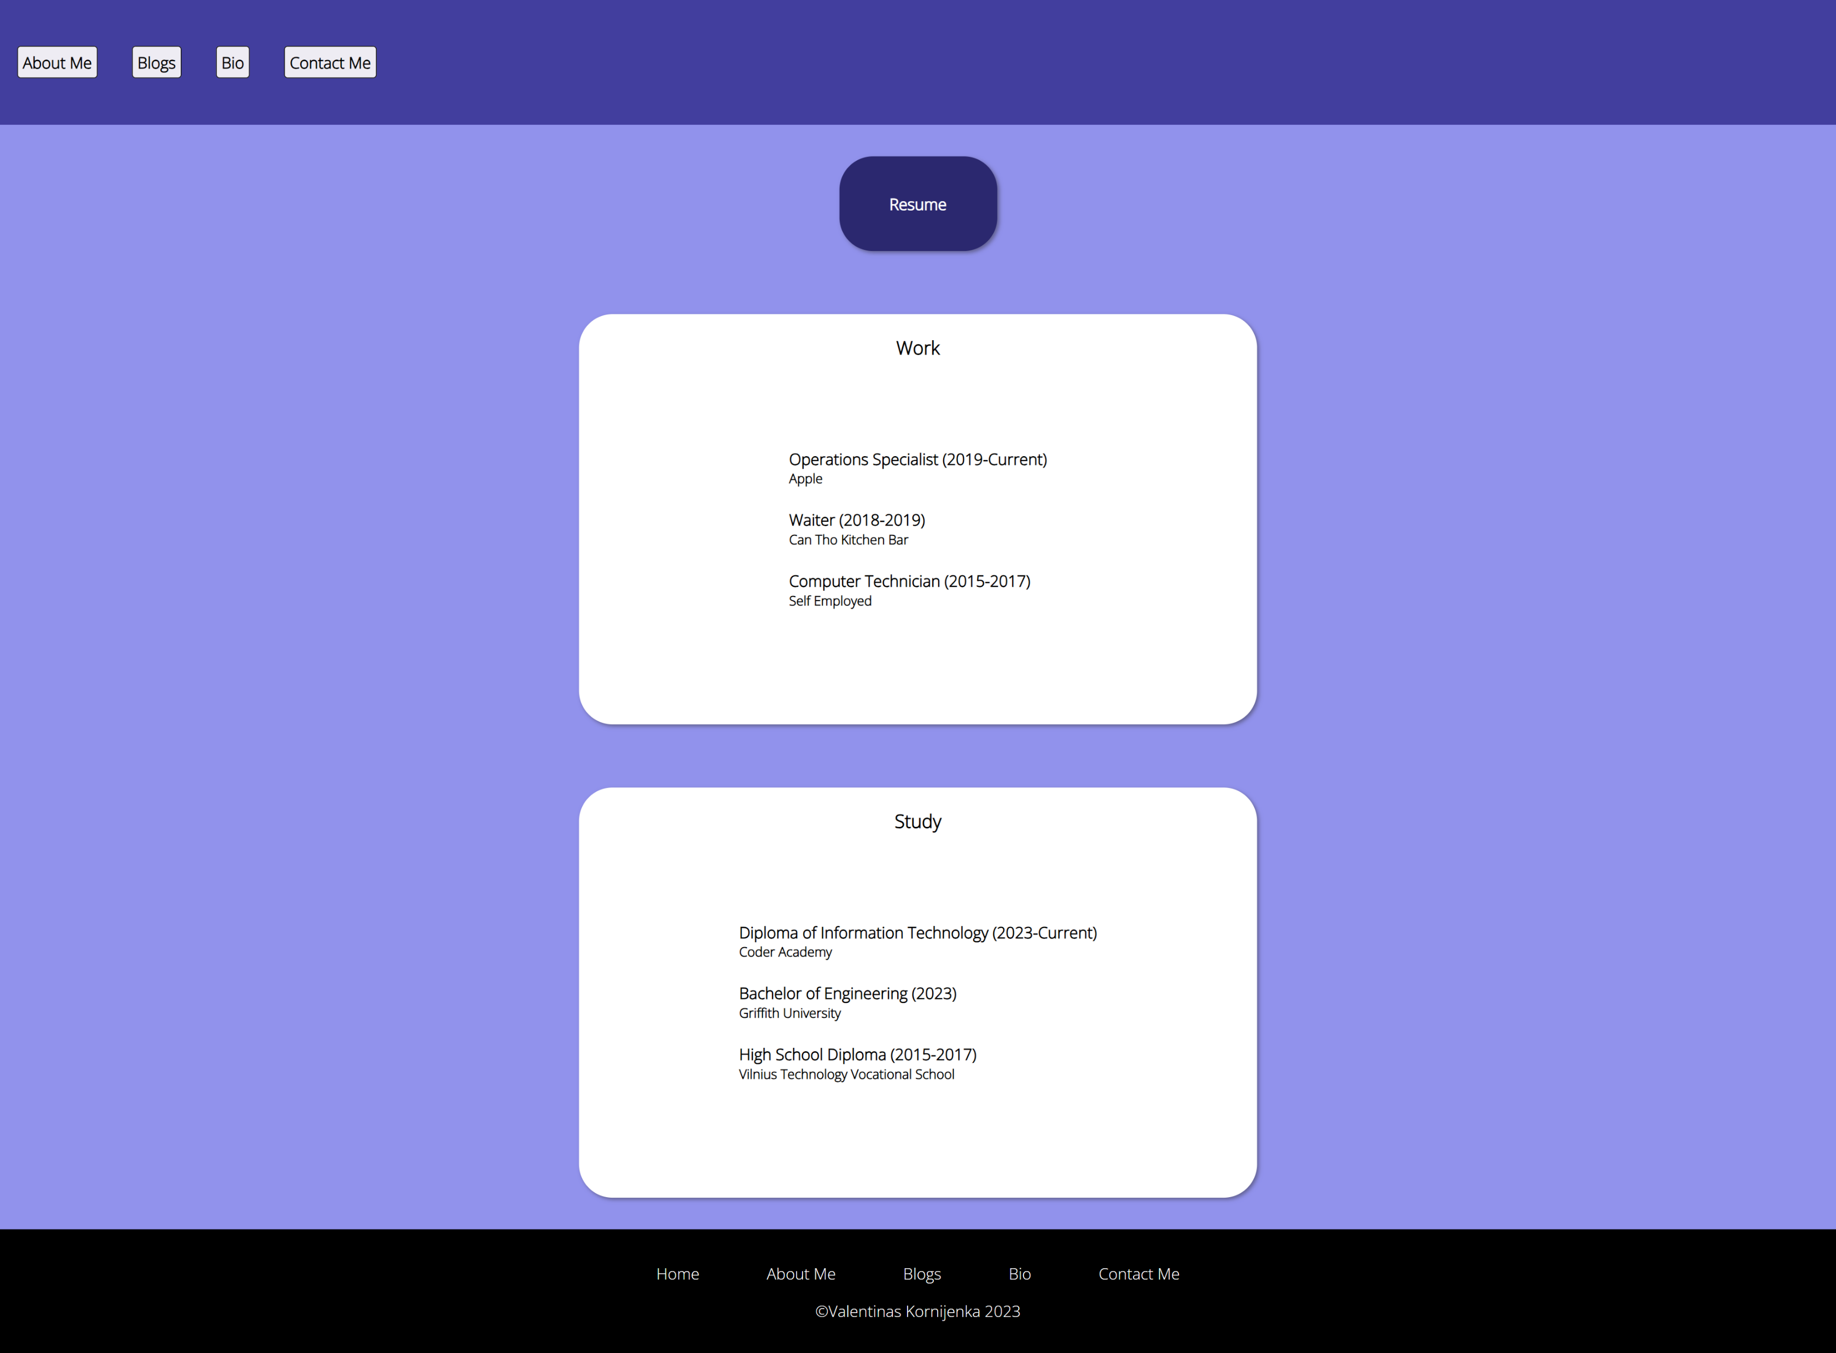
Desktop

Slide 20
Blog Landing

Slide 21
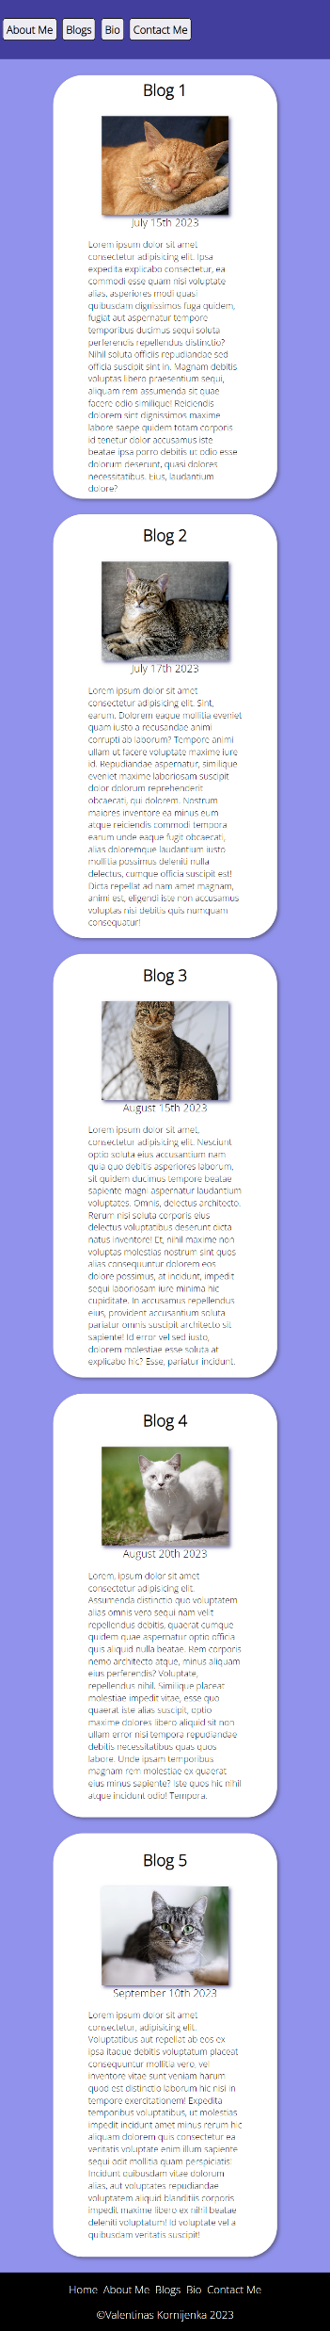
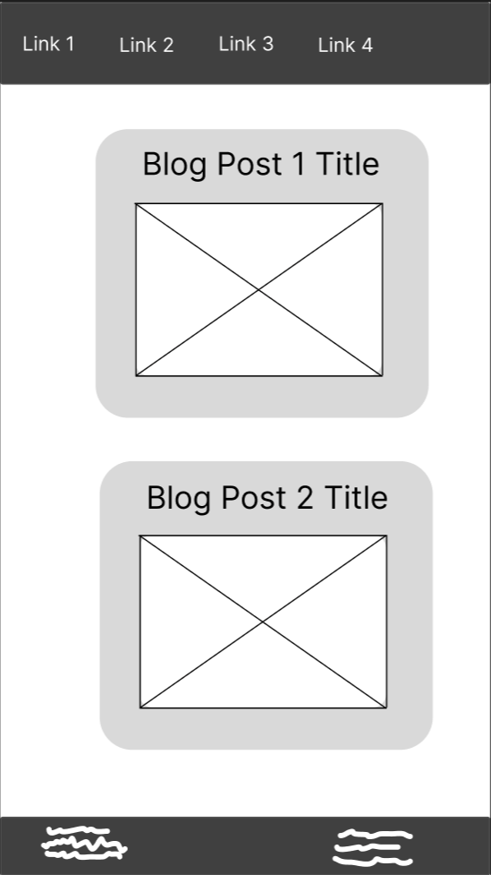
Phone
Navigation button changes colour with transition.

Slide 22
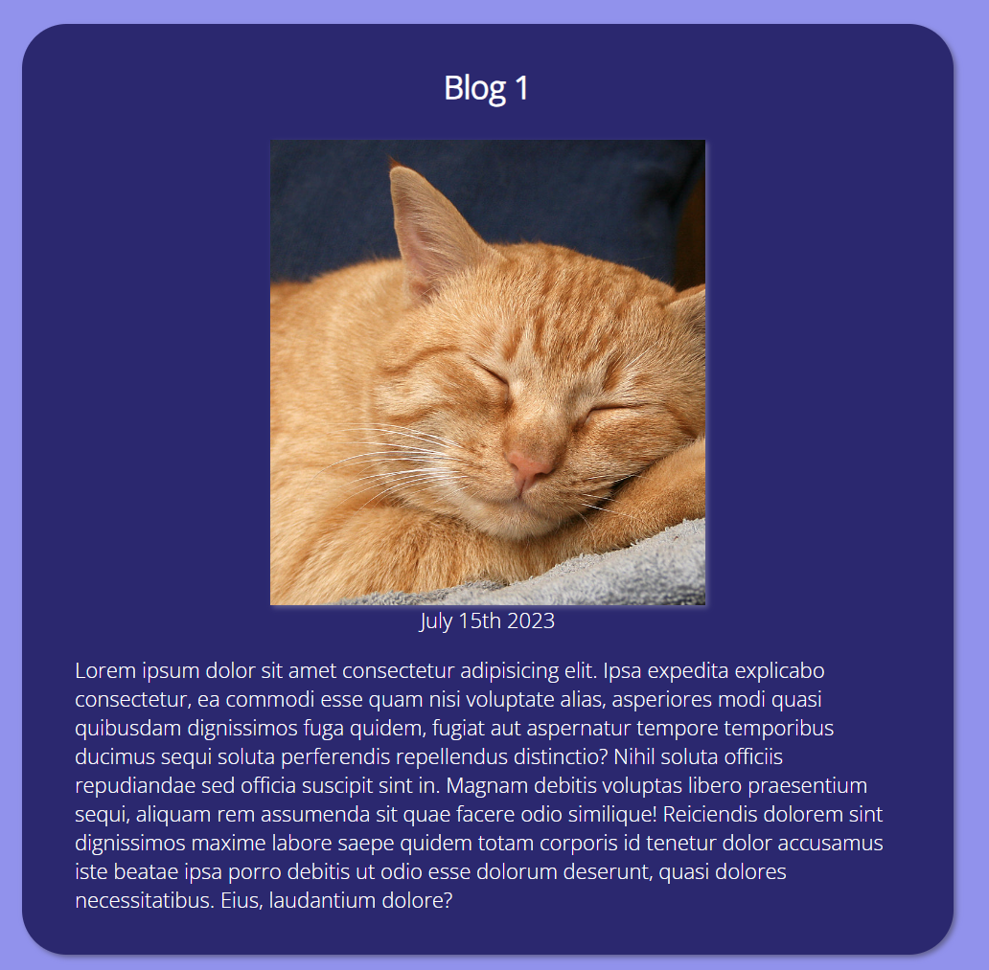
Main Component
Upon hover, main component container changes colour and slightly increased in size.
Transition: 0.2s ease

Slide 23
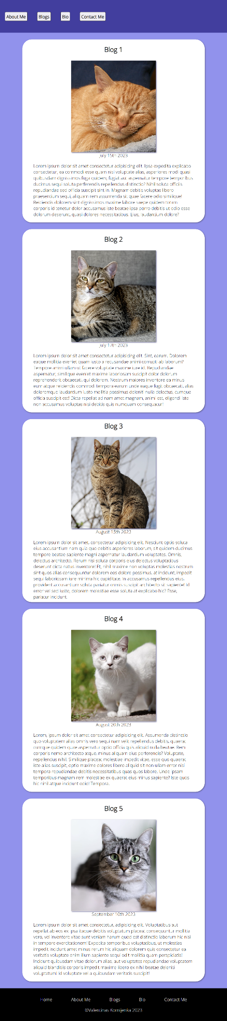
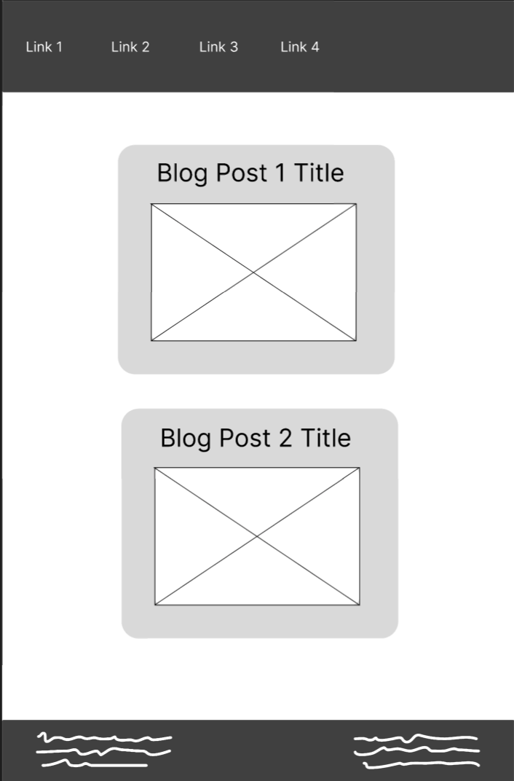
Tablet

Slide 24
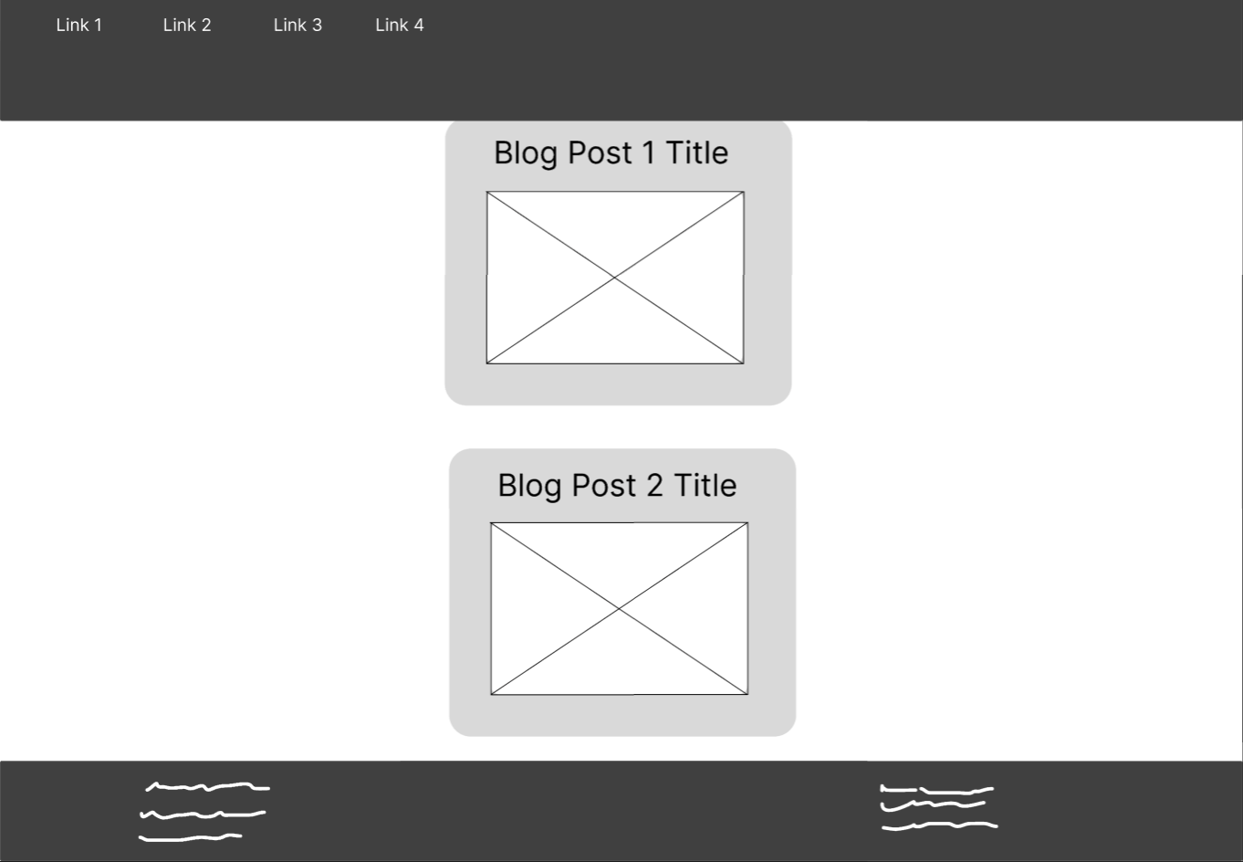
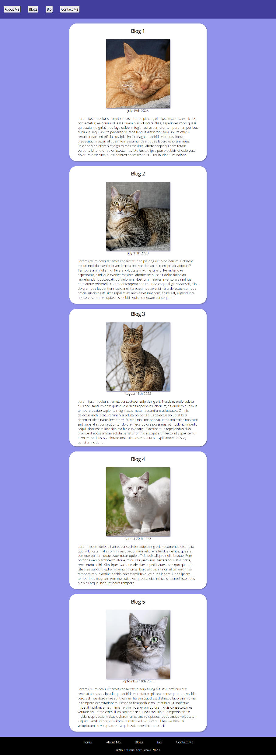
Desktop

Slide 25
Blog Example

Slide 26
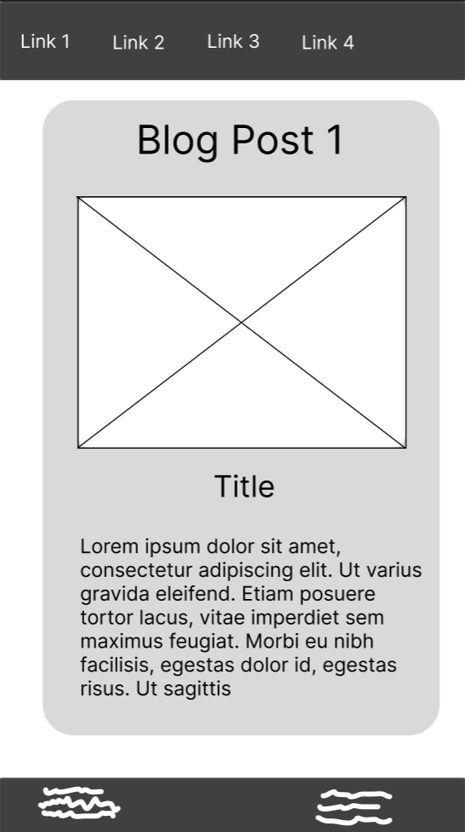
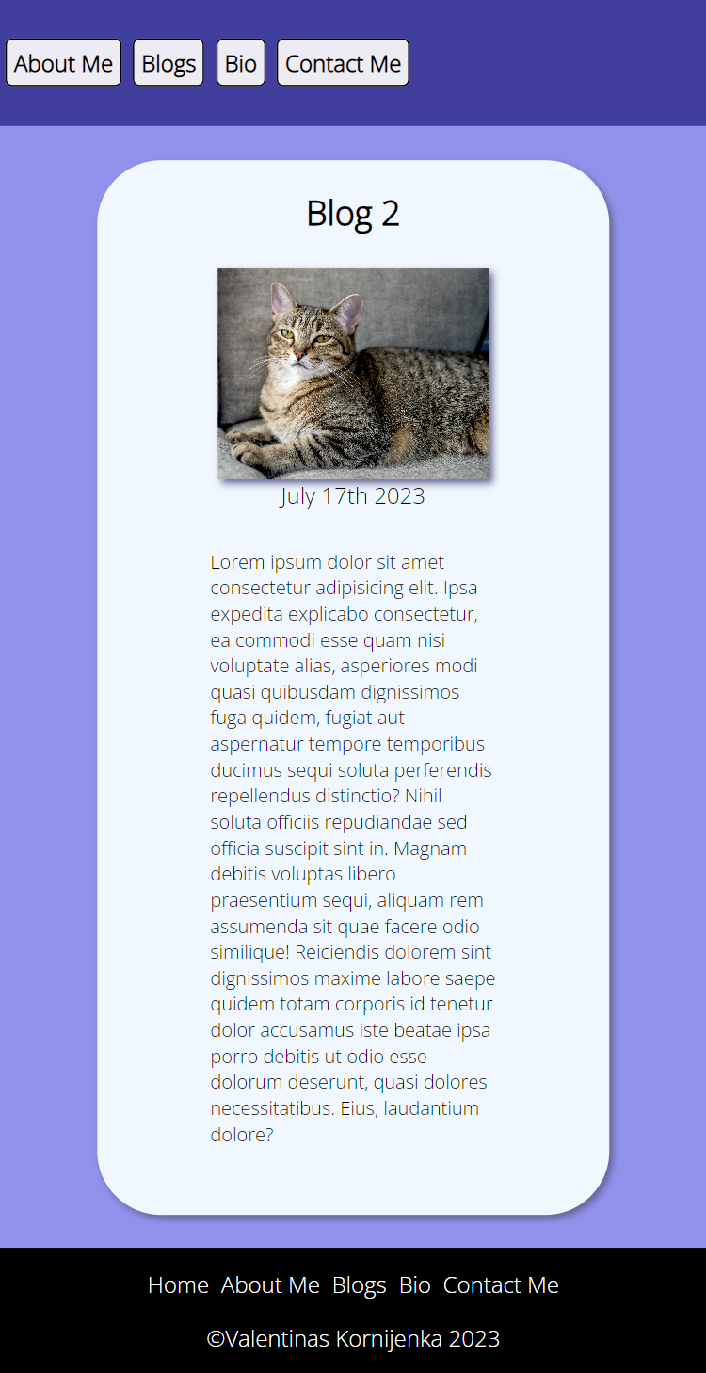
Phone
Colour changed to alice blue to distinguish from landing page.

Slide 27
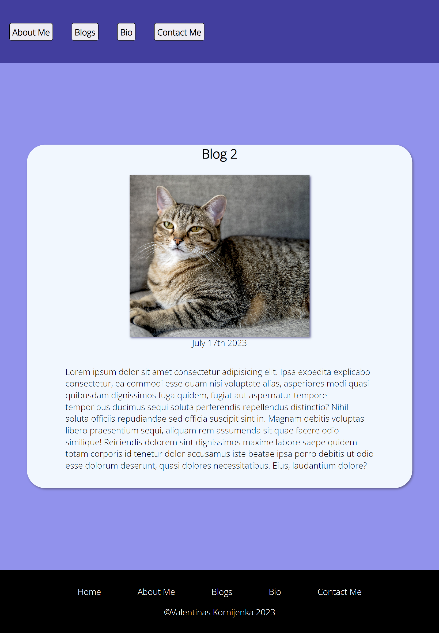
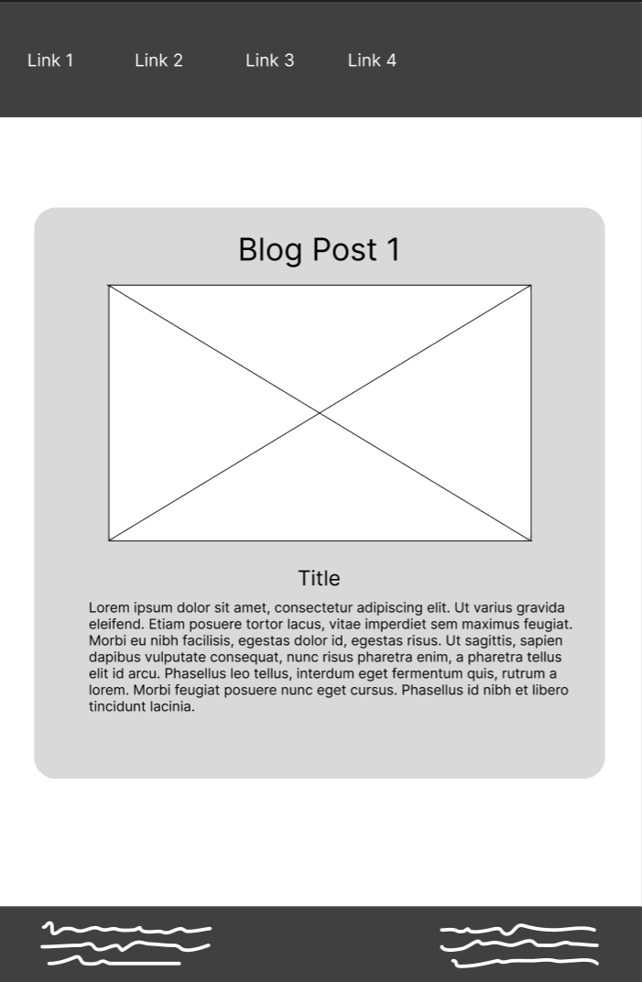
Tablet

Slide 28
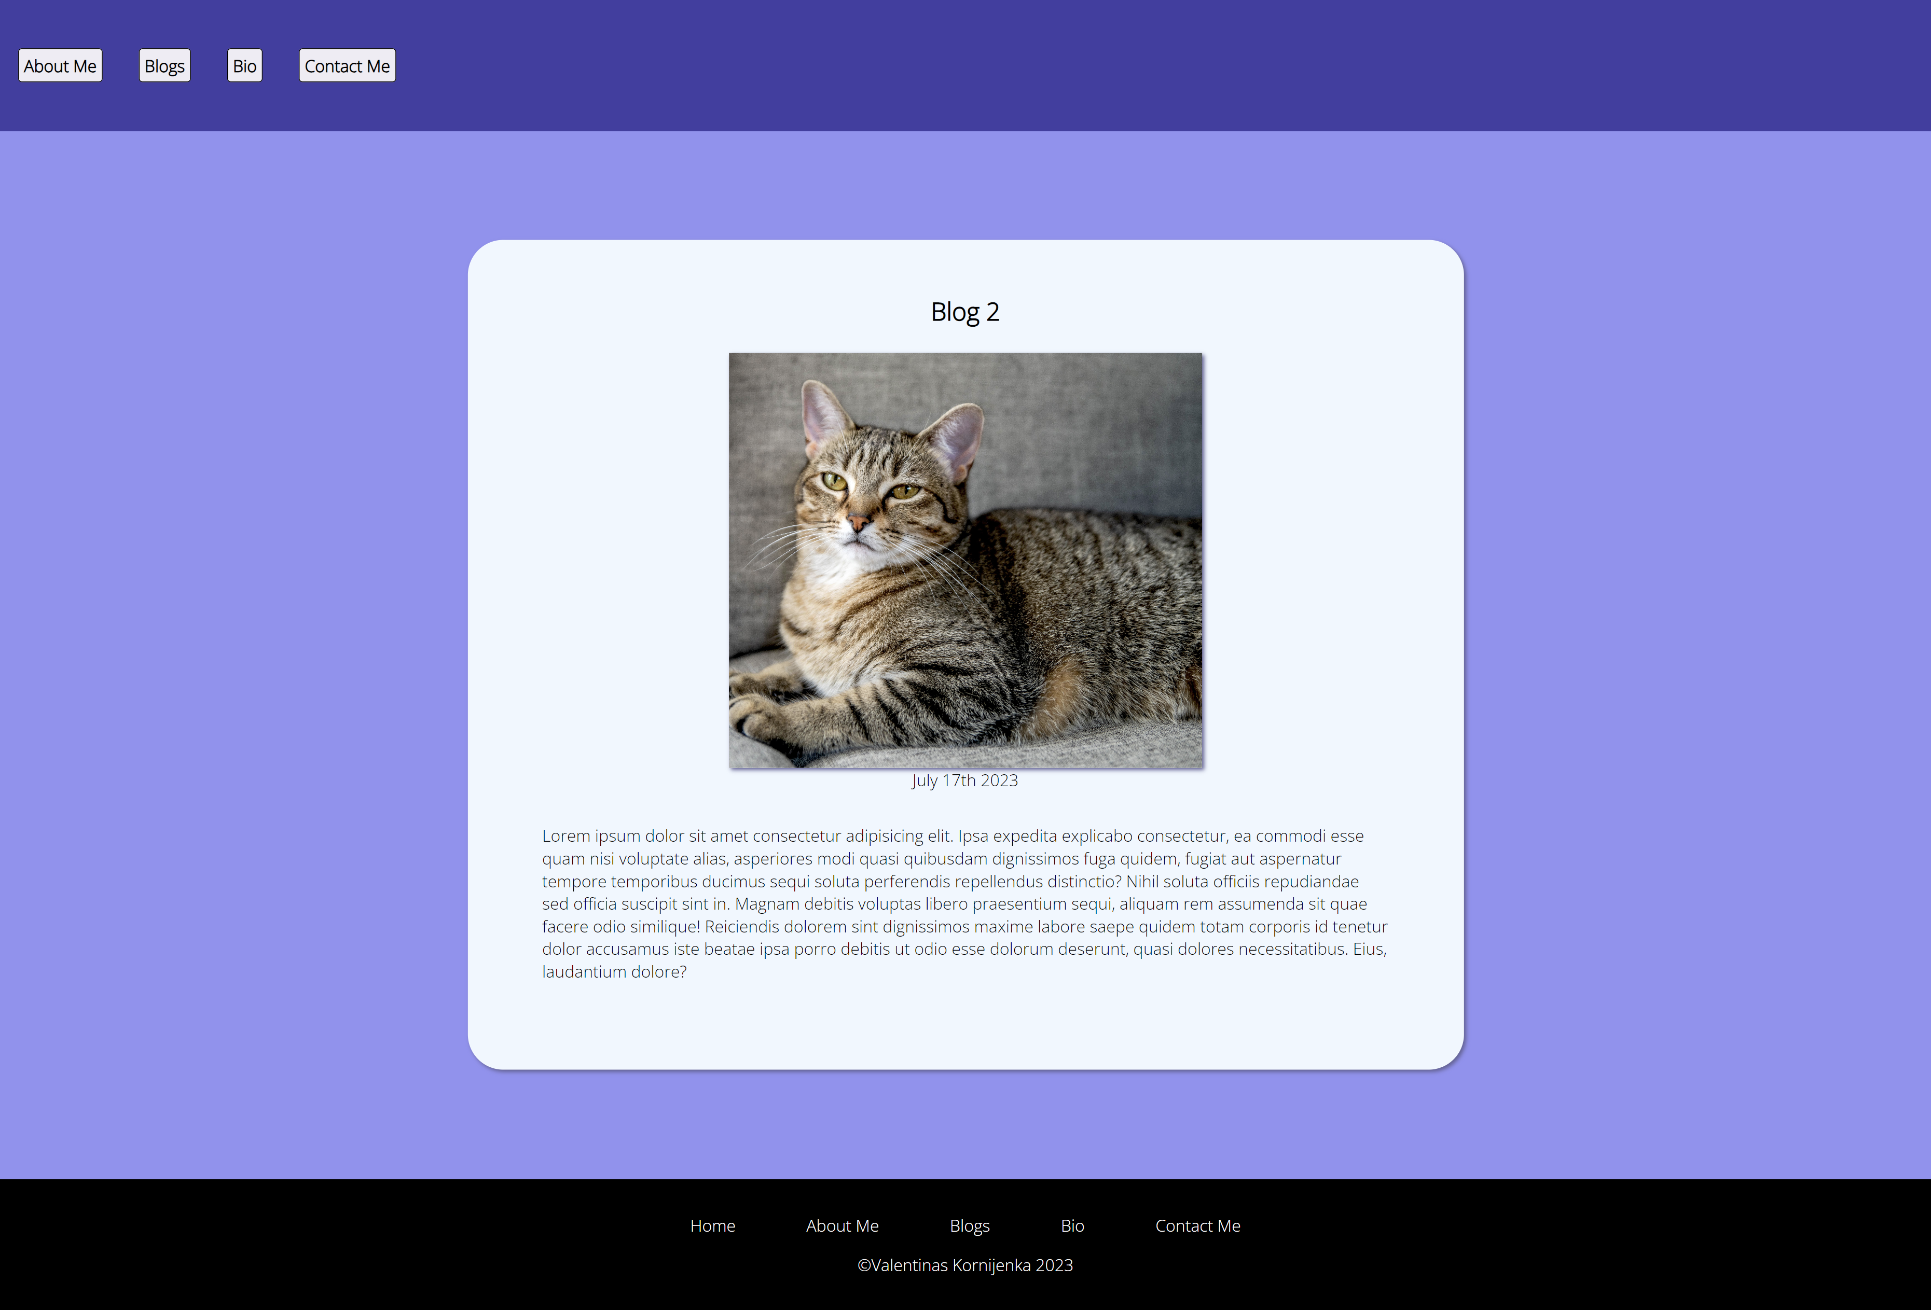
Desktop

Slide 29
Contact Me Page

Slide 30
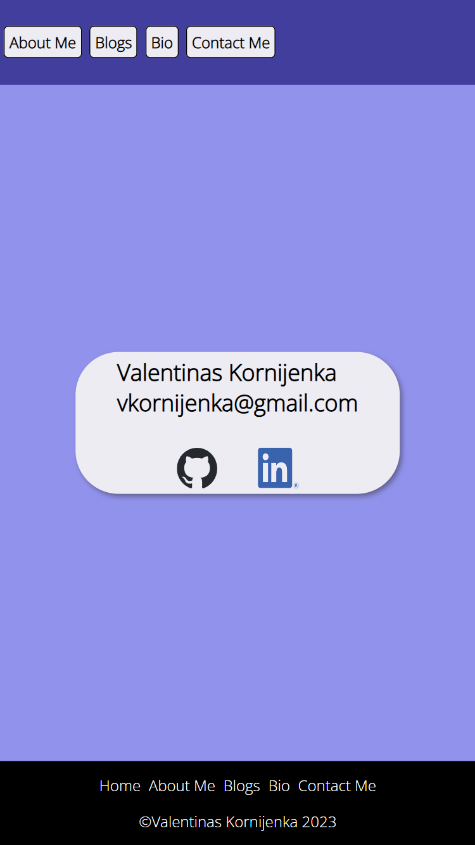
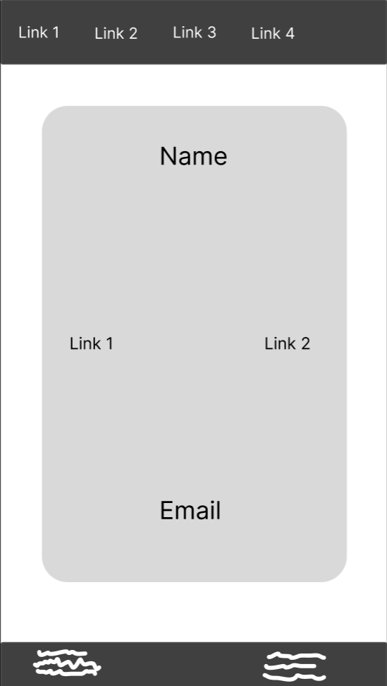
Phone
Inspired by calling card, changed design from large box.
Included socials for ease of access.

Slide 31
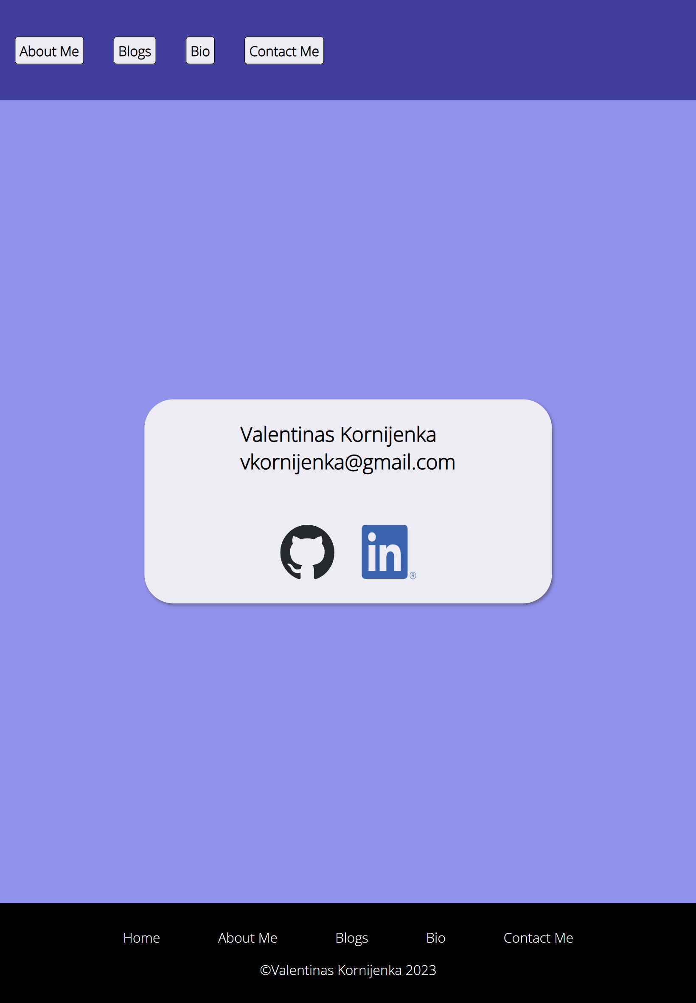
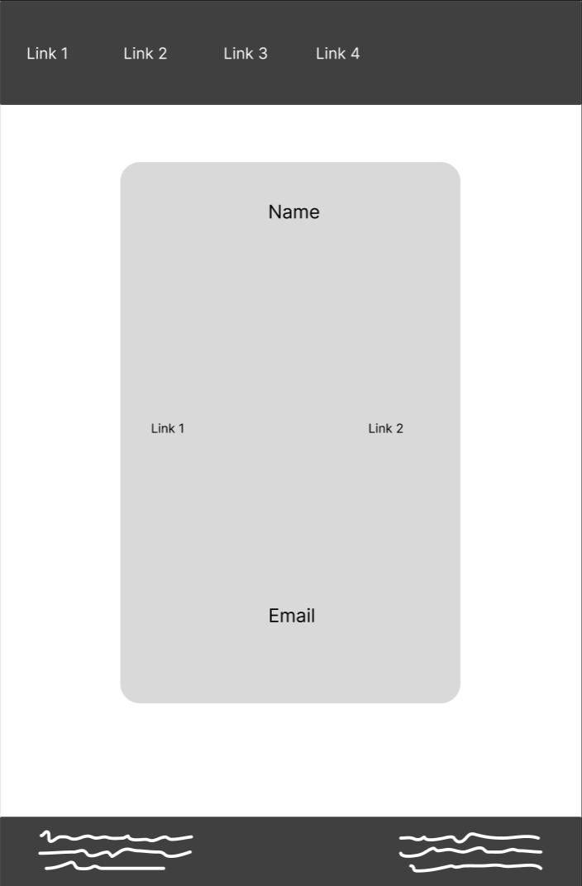
Tablet

Slide 32
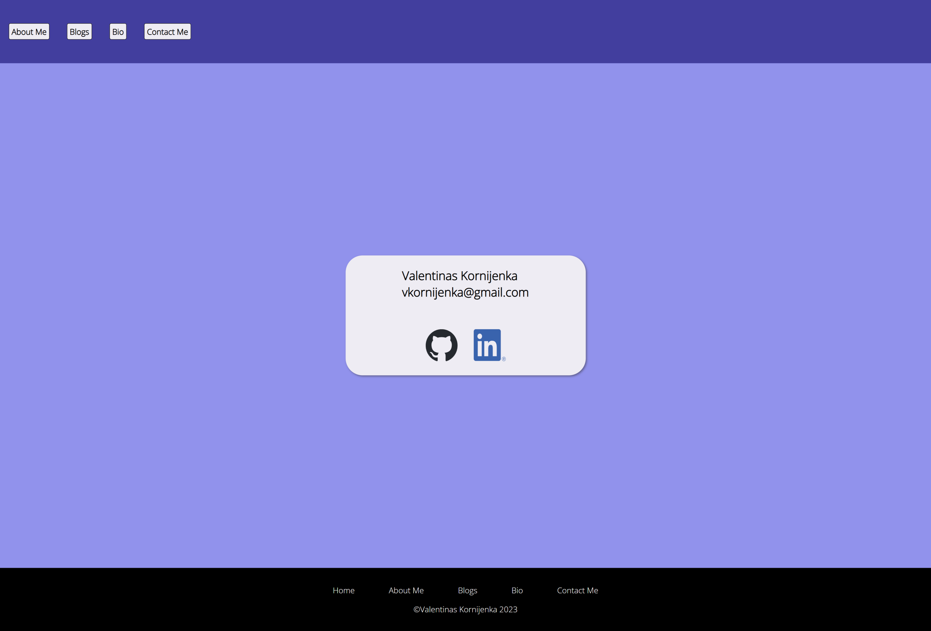
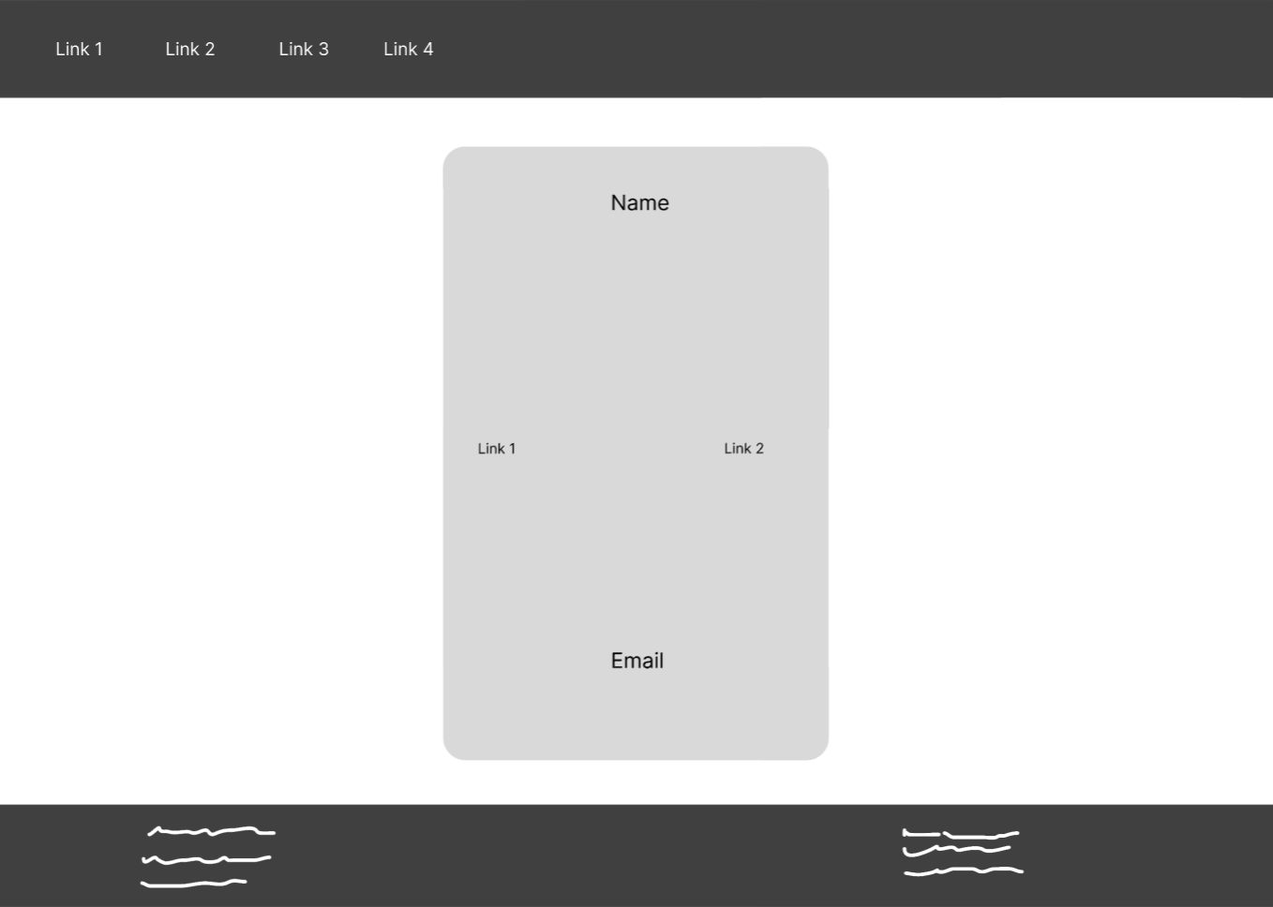
Desktop

Slide 33
Discussion
Challenges
Favourite Parts
Keeping code DRY.
Not managing time as well as I could.
Not taking sufficient breaks.
Writing too much redundant code.
Adding animations to website.
Learning new things!

